Slide 1
STATES OF MATTER
Solids , liquids and gases

Slide 2
Kinetic theory of matter
1. All matter is composed of tiny particles
Ions , atoms or molecules
2. There are 3 states of matter :
Solid , liquid and gas

Slide 3
Basic differences between the 3 states are
Order / arrangement of particles
Motion of particles
Attractive forces between particles

Slide 4
Solids
a. particles packed closely together in an orderly arrangement
b. strong forces between particles
c. small amounts of energy. Particles vibrate about fixed positions

Slide 5
Liquids
a. particles are slightly further apart
b. weaker forces between particles
c. larger amounts of energy. Particles can move freely around each other but in close proximity. Have vibrational , rotational and translational energy

Slide 6
Gases
a. particles are much widely separated
b. almost no forces or weak forces between
particles
c. much larger amounts of energy. Particles
move rapidly and randomly into any
space available. Have vibrational ,
rotational and translational energy

Slide 7
Difference in behavior when placed in a container :
a. solids keep their shape and volume , no matter what container they are in
b. liquids take up the shape of their container but do not necessarily fill it
c. gases quickly take up the shape of their container and always fill it

Slide 8
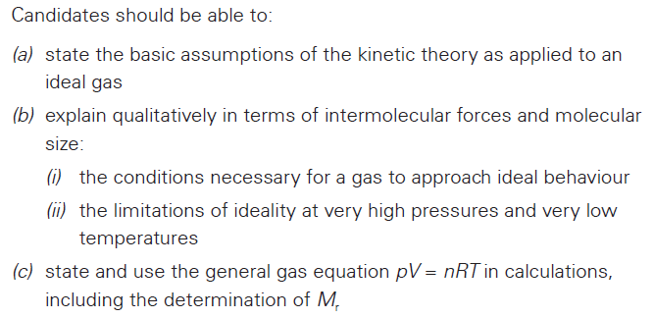
Learning objectives (Gases)

Slide 9
GASES
1. Gas laws :
a. Boyles’ Law : the volume of a fixed mass of gas is inversely proportional to the pressure , at constant temperature
v α 1/p
pv = constant
p₁v₁ = p₂v₂

Slide 10
v
1/p

Slide 11
v
p

Slide 12
pv
1/v

Slide 13
pv
p

Slide 14
b. Charles Law : the volume of a gas is proportional to the temperature ( expressed in Kelvin ) at constant pressure.
v α T
v/ T = constant
v₁ / T₁ = v₂ / T₂

Slide 15
v
T ( in K )

Slide 16
v
T / ⁰ C
- 273

Slide 17
c. The constant volume law : the pressure is proportional to the temperature (in kelvin) provided its volume remains constant.
P α T
P / T = constant
P₁/ T₁= P₂ / T₂

Slide 18
P
T ( in K )

Slide 19
2. Combining gas laws :
PV = nRT
Ideal / general gas equation (calculate M_{r})
3. Equation of state :
used to calculate the volume a gas would
occupy under different conditions of temp
and pressure

Slide 20
Equation of state

Slide 21
Eg : P₁ = 101315 Pa , V₁ = 50 cm³ ,
T₁ = 20⁰ C
Calculate the volume of the gas at s.t.p.
s.t.p → P₂ = 101000 Pa , T₂ = 273 K
Substituting into equation :
V₂ = 46.7 cm³

Slide 22
4. Dalton’s law of partial pressure :
a. Dalton’s law : The total pressure of a mixture of gases is the sum of the partial pressures of all the component gases.
Eg:
For a mixture of 2 gases , A and B
P_{T} = P_{A} + P_{B}

Slide 23
b. in a mixture of 2 gases A and B ,
the partial pressure of a gas A , P_{A}
P_{A} = mole fraction of A x total P (P_{T})
where mole fraction of A , X_{A}
= no of moles of A / total no of moles of
gases

Slide 24
X_{A} =

Slide 25
if all gases are measured under the same conditions ,
X_{A} = volume of A / vol of A + vol of B

Slide 26
Question
(1) A mixture of 2 moles of hydrogen and 1 mole of oxygen has a total pressure of 100KPa. Find the partial pressure of each gas.

Slide 27
2 moles H₂ , 1 mole O₂ , P_{T} = 100 kPa
P_{O2} = 1/3 x 100 kPa = 33.3 kPa
P_{H2} = 2/3 x 100 kPa = 66.7 kPa
or P_{H2} = P_{T} – P_{O2}

Slide 28
Question
(2) 5 dm³ sample of oxygen at a pressure of 200 kPa and 2 dm³ sample of nitrogen at a pressure of 500 kPa were introduced into a 2.5 dm³ vessel. What is the total pressure in the vessel?

Slide 29
5 dm³ O₂ , P = 200 kPa
2 dm³ N₂ , P = 500 kPa
new volume = 2.5 dm³
P₁V₁ = P₂V₂
For O₂ : 5 x 200 = 2.5 x P_{O2}
P_{O2} = 400 kPa

Slide 30
For N₂ : 2 x 500 = 2.5 x P_{N2}
P_{N2} = 400 kPa
P_{T} = P_{O2} + P_{N2}
= 400 + 400
= 800 kPa

Slide 31
Question
A small spacecraft of capacity 10 m³ is connected to another of capacity 30 m³. Before connection, the pressure inside the smaller craft is 50 kPa and that inside the larger is 100 kPa. If all measurements are made at the same temperature , what is the pressure in the combined arrangement after connection ?

Slide 32
P₁V₁=P₂V₂
Smaller craft : 50 x 10 = P₂ x 40
P₂ = 12.5 kPa
Larger craft : 100 x 30 = P₂ x 40
P₂ = 75 kPa
P_{T} = 12.5 kPa + 75 kPa
= 87.5 kPa

Slide 33
Questions
1. When 4.20g of a compound was completely vaporised in a gas syringe at 27ºC and a pressure of 80kPa and 1dm³ vapour was produced. Calculate the relative molecular mass of the compound.
2. A certain compound of C, H and Cl is found to have a vapour density of 3.17gdm⁻³ at 100ºC and 101.3kPa. What is the relative molecular mass of the compound?

Slide 34
Kinetic theory of gases
Basic assumptions (features of an ideal gas):
1. gas particles have negligible volume compared to volume of gas (*)
2. no forces of attraction between gas particles (*)
3. all collisions between the molecules are perfectly elastic

Slide 35
4. particles are continuously moving at random
5. average speed and average kinetic energy of the gas particles are directly proportional to the temperature
6. at the same temperature, molecules of every gas have the same average kinetic energy
( know at least 4 assumptions )

Slide 36
REAL GASES
1. Gases that shows deviation from ideal gas behaviour = real gases
2. Deviations occurs because 2 of the assumptions are not valid for a real gas.

Slide 37
Real gases have the following features :
a. gas particles have a definite volume / do not have negligible volume
b. there are attractive forces between particles though they are usually very weak

Slide 38
3. Real gas behaves more ideally under :
a. low pressure :
few molecules which are widely spaced
little intermolecular attraction and
particles have negligible volume

Slide 39
b. high temperature :
molecules move rapidly and intermolecular forces are not significant
4. Real gases shows biggest deviation from ideal behaviour under :
a. high pressure :
many molecules packed closely together

Slide 40
Therefore,
i) significant forces of attraction between
particles
ii) volume of particles not negligible
b. low temperature :
Gas particles have low kinetic energy , move slowly and forms significant intermolecular attraction

Slide 41
5. Different gases shows different degree of deviation , which depends on
a. mainly intermolecular force of attraction
stronger forces of attraction ,
greater deviation
eg : CO₂ vs NH₃
VDW in CO₂ weaker than H-bond in NH₃
NH₃ shows greater deviation

Slide 42
eg : CO₂ vs NH₃
CO₂ has VDW
NH₃ has H-bonds as well as VDW
H-bonds are stronger
NH₃ shows greater deviation

Slide 43
b. size of gas molecule / volume
Bigger size/ greater volume , greater deviation
Eg : O₂ vs CO₂
CO₂ has more electrons therefore stronger VDW and also has larger volume
CO₂ shows greater deviation

Slide 44
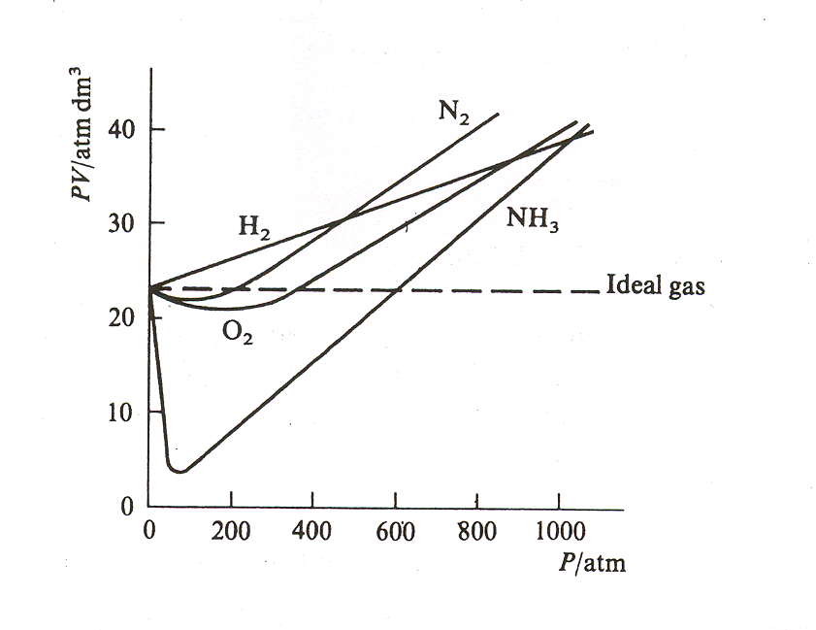

Slide 45

Learning objectives (Liquids)
Candidates should be able to

Slide 46
LIQUIDS
1. Change of state :
Boiling /vaporisation
melting
solid
liquid
gases
freezing
condensation
sublimation
endothermic
exothermic

Slide 47
a. solids must gain energy to melt
energy required to overcome some of the
strong forces holding particles in fixed
positions
b. liquids must gain energy to boil
energy required to completely break the
forces between particles in liquid

Slide 48
2. Kinetic molecular model :
Eg : liquid → gas as temperature increases
Average kinetic energy of molecules increases
Intermolecular forces are more easily broken

Slide 49
3. Vapour pressure :
a. liquids exert vapour pressure
Molecules vaporise from surface of liquid to become gas
Vapour molecules exert a pressure on the walls of any closed container

Slide 50
b. vapour pressure increases with temperature,
At higher temp : Molecules have more kinetic energy and can vaporise more easily
More vapour molecules , higher vapour pressure
c. when vapour pressure = atmospheric pressure , liquid boils

Slide 51
Note :
Saturated vapour pressure
Evaporation in a closed container continues until rate of evaporation = rate of condensation
At this point , vapour is saturated
Pressure exerted is called saturated vapour pressure

Slide 52
Learning objectives (Solids)
Candidates should be able to :
1)Describe the lattice structures of
a) giant ionic solids
b) giant molecular solids
c) giant metallic solids
d) simple molecular solids
2) Relate the structure to physical properties

Slide 53
SOLIDS
1. Solids are crystalline.
Particles arranged in regular and orderly
arrangement
Represented by a lattice
2. Lattice particles : atoms , ions or
molecules

Slide 54
3. Coordination number = no of nearest
neighbours
Larger coordination no , solid more dense
4. Four types of solids :
Giant ionic solid , giant molecular solid ,
giant metallic solid and simple molecular
solid

Slide 55
Giant Ionic Solid
1. Consists of oppositely charged ions packed closely together.
Distance between the nuclei of adjacent ions is the sum of the 2 ionic radii
Eg : Na⁺ = 0.095 nm , Cl⁻ = 0.181 nm
Distance = 0.095 + 0.181
= 0.276 nm

Slide 56
2. Eg : solid NaCl
a. simple cubic structure , face centred cubic structure
b. coordination number - 6 : 6

Slide 57
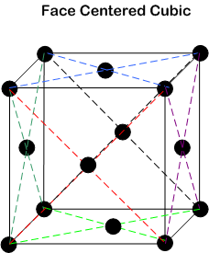

Slide 58
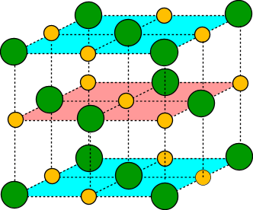
GIANT IONIC SOLIDS
Oppositely charged ions held in a regular
3-dimensional lattice by electrostatic attraction
Eg : solid NaCl
Cl⁻
Chloride ion
Na⁺
Sodium ion

Slide 59
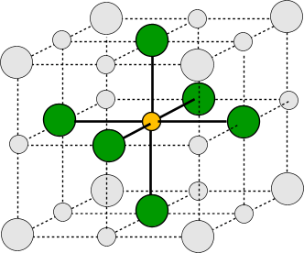
Each Na⁺ is surrounded by 6 Cl¯ (co-ordination number = 6)
and each Cl¯ is surrounded by 6 Na⁺ (co-ordination number = 6).

Slide 60
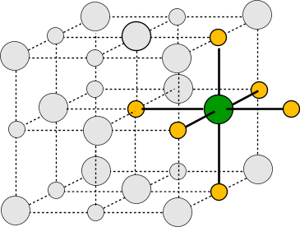
Each Na⁺ is surrounded by 6 Cl¯ (coordination number = 6)
and each Cl¯ is surrounded by 6 Na⁺ (coordination number = 6).
Coordination number of NaCl = 6 : 6

Slide 61
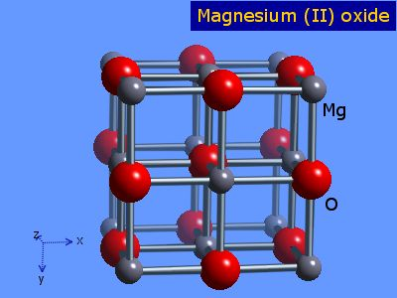
Another eg : MgO ( similar to NaCl )

Slide 62
3. Type of bond : ionic bond
4. Properties :
a. ions in fixed positions – good conductors when molten or in aqueous solution
b. strong ionic bonds – high melting point
c. strong bonds and ions held together closely and rigidly in fixed positions - hard

Slide 63
d. ions arranged in regular lattice ( have good cleavage planes ) – brittle

Slide 64
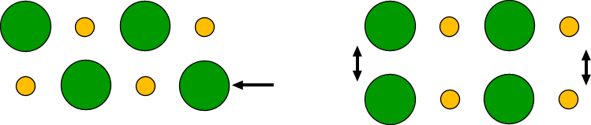
BRITTLE IONIC LATTICES
-
-
-
+
-
+
+
+
+
+
+
-
+
-
-
+
-
+
+
+
IF YOU MOVE A LAYER OF IONS, YOU GET IONS OF THE SAME CHARGE NEXT TO EACH OTHER. THE LAYERS REPEL EACH OTHER AND THE CRYSTAL BREAKS UP.

Slide 65
e. forms ion-dipole attraction with water molecules - generally soluble in water
Note : compounds with ions of high charge density ( charge/size ) not soluble eg MgO , Al₂O₃

Slide 66
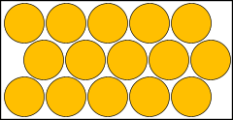
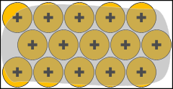
Giant metallic solid
1. Lattice of positive ions surrounded by a sea of delocalised ( mobile or free ) electrons
Atoms arrange in regular close packed 3-dimensional crystal lattices.
The outer shell electrons of each atom leave to join a mobile “cloud” or “sea” of electrons which can roam throughout the metal. The electron cloud binds the newly-formed positive ions together.

Slide 67
2. Type of bond : metallic bond
3. Have high coordination no – dense solids
4. Properties :
a. strong metallic bonds – high melting point
b. mobile electrons – good conductors when solid or liquid

Slide 68
c. atoms held closely together by strong bonds in fixed positions – hard
d. rigid non directional bonds , atoms can slide over each other without breaking metallic bonds – malleable and ductile

Slide 69

METALLIC PROPERTIES
Metals can have their shapes changed relatively easily
MALLEABLE CAN BE HAMMERED INTO SHEETS
DUCTILE CAN BE DRAWN INTO RODS AND WIRES
As the metal is beaten into another shape the delocalised electron cloud continues to bind the “ions” together. Metallic bonds are non-directional.
Some metals, such as gold, can be hammered into sheets thin enough to be translucent.

Slide 70
Giant molecular ( covalent ) solid / macromolecular solid
1. Covalent bonds between atoms bind all atoms into a giant molecule.
Egs :
1) diamond , graphite , silica SiO₂
2) silicon carbide , (SiC)_{n} : hard material
similar to diamond which is also hard
3) silicon , germanium

Slide 71
a. Diamond:
i) many strong covalent bonds :
very high melting point
ii) each carbon is joined to 4 others in a rigid structure : hard and strong
iii) all valence electrons used in bonding, no free electrons : non conductor

Slide 72
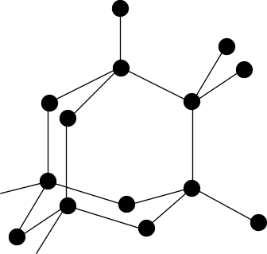
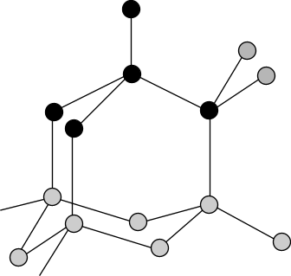
Each C bonded to 4 other atoms
Giant molecular structure
Coordination no = 4

Slide 73
b. Graphite :
i) many strong covalent bonds :
very high melting point
ii) each carbon atom is joined to 3 others in a layered structure,
layers are held by weak VDW forces and can slide over each other :
soft (used as lubricants )

Slide 74
iii) only 3 electrons used for bonding,
presence of free electrons :
the fourth electron moves freely along the layers
therefore conductor

Slide 75
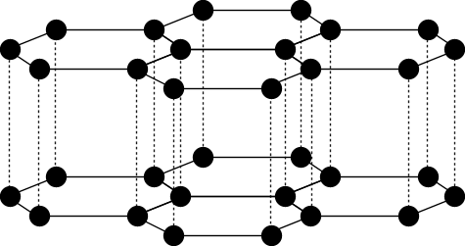
Giant molecular structure
Layered structure
Each C bonded to 3 other atoms
Coordination no=3

Slide 76
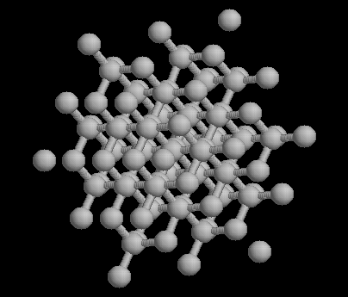
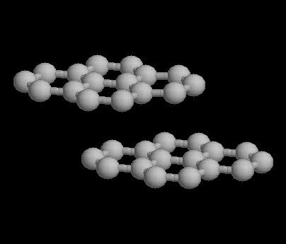
GIANT (MACRO) MOLECULES
DIAMOND
GRAPHITE

Slide 77
c. Silica, SiO₂ (silicon IV oxide) :
i) many strong covalent bonds:
very high melting points
ii) each silicon is joined to 4 oxygen atoms, and each oxygen is joined to 2 silicon atoms:
strong and hard
iii) all valence electrons used in bonding, no free electrons : non conductor

Slide 78
silicon
oxygen

Slide 79
2. Type of bond : covalent bond
3. General properties :
a. atoms held by numerous strong
covalent bonds in a rigid structure – hard
and very high melting point
b. no free electrons or ions – non
conductor ( except graphite )

Slide 80
4. Comparing graphite and diamond :
a. C-C bond in graphite is stronger
- intermediate between single and double
bond
- C-C bond in diamond is a single bond
- graphite has higher melting point

Slide 81
Note :
All C-C bonds in graphite are same length
due to delocalised π orbitals

Slide 82
b. Graphite is soft
- layers of atoms held by weak VDW
forces , can slide over each other easily
- soft ( used as lubricant )
Diamond is hard
- strong C-C bonds between atoms
arranged in a rigid tetrahedral structure

Slide 83
c. Delocalised electrons in graphite
- conducts electricity in a direction
parallel to the planes containing the
hexagonal rings
but poor conductor perpendicular to the
planes
as electrons are unable to move
between planes

Slide 84
- Diamond is a non conductor
all electrons are involved in bonding , no
delocalised/free electrons

Slide 85
Simple molecular solids / molecular solids
1. Atoms are joined together within the molecule by strong covalent bonds
but the non polar molecules are attracted by weak VDW forces
Egs :
Solid I₂ , solid CO₂ , solid sulphur (S₈)

Slide 86
Structure of solid I₂
Face centred cubic structure
I₂ molecules arranged in a cube with a molecule at each corner and one at the centre of each face

Slide 87
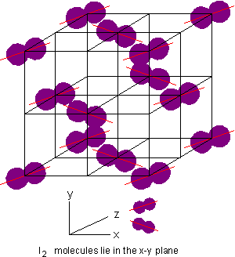
Solid iodine

Slide 88
2. Properties :
a. weak VDW forces between molecules
molecules easily separated
- soft and low melting point
b. no free mobile electrons or ions
- non conductor

Slide 89
Hydrogen bonded solid
Eg : ice
Simple molecular solid
Each H₂O surrounded tetrahedrally by 4 other molecules by hydrogen bonds
Open structure
Ice less dense than liquid water

Slide 90
Modern use of materials
1. Metals :
a. Aluminium :
i) properties
- light yet strong
- malleable and ductile
- resists corrosion

Slide 91
Corrosion resistant :
Exposed to air , layer of oxide forms on the surface
Oxide layer is non porous and adhering
Seals off the metal from oxygen , no further oxidation

Slide 92
ii) Uses of Al metal :
(1)Excellent conductor of heat and electricity - used as heat exchangers
(2)highly reflective – used in roofing to insulate buildings
(3)Non toxic – used to make food equipment and in packaging

Slide 93
iii) Uses of Al alloys :
Duralumin ( Al , Mg , Cu ) and
magnalium ( Ca , Al , Mg )
Light yet strong
Used in construction of aircrafts and ships

Slide 94
b. Copper :
i) Uses of copper metal :
(1)high electrical conductivity – used for electrical wiring
(2)chemically inert – used in domestic and gas pipework

Slide 95
(3) Has catalytic properties – used as catalyst in oxidation of methanol
ii) Uses of copper alloys :
(1)brass ( Cu , Zn ) – used for making screws, hinges, decorative items , working parts of watches and clocks

Slide 96
(2)bronze ( Cu , Sn ) – used for bearings and ship’s propellers
(3)cupro nickel ( Cu , Ni ) – used for making coins

Slide 97
2. Ceramics :
a. have giant structures
b. properties :
i) high melting point
ii) resistant to wear and abrasion
iii)resistant to heat and chemical attack
iv) less likely to deform under compression
v) electrical insulator

Slide 98
c. Uses of ceramics :
i) as furnace linings which must withstand high temperatures
Eg : Al₂O₃ ( m.p = 2300⁰ C)
MgO ( m.p = 2800⁰ C )
ii) in crockery, china, porcelain ,pottery eg
SiO₂
iii) as electrical insulators eg MgO ,SiC , Si₃N₄

